Slide 1
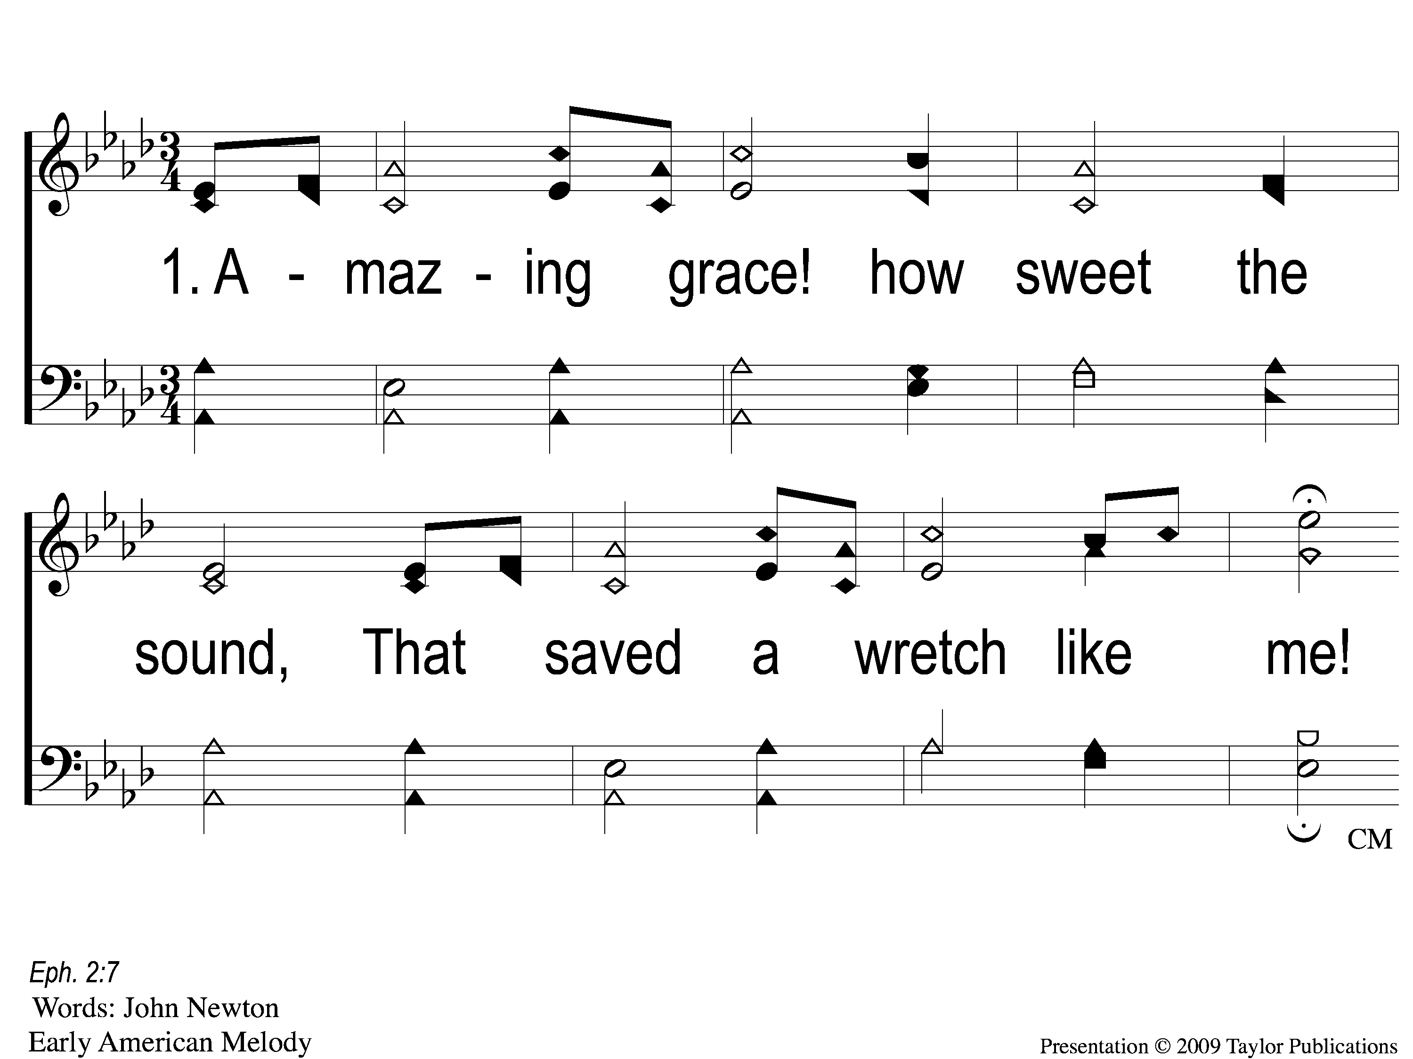
1-1 Amazing Grace
Amazing Grace
12

Slide 2
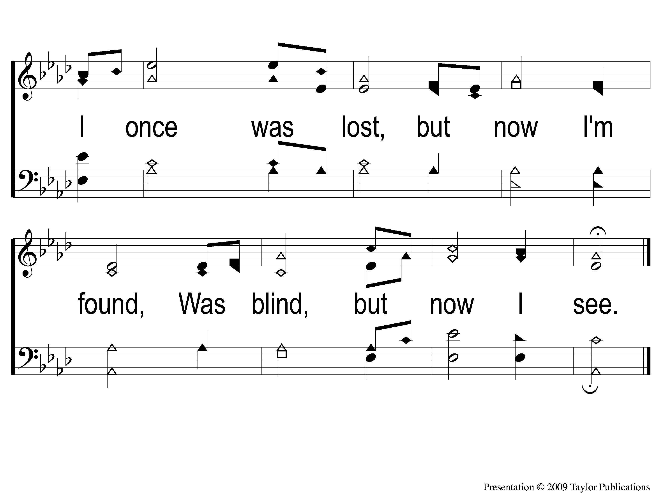
1-2 Amazing Grace
Amazing Grace
12

Slide 3
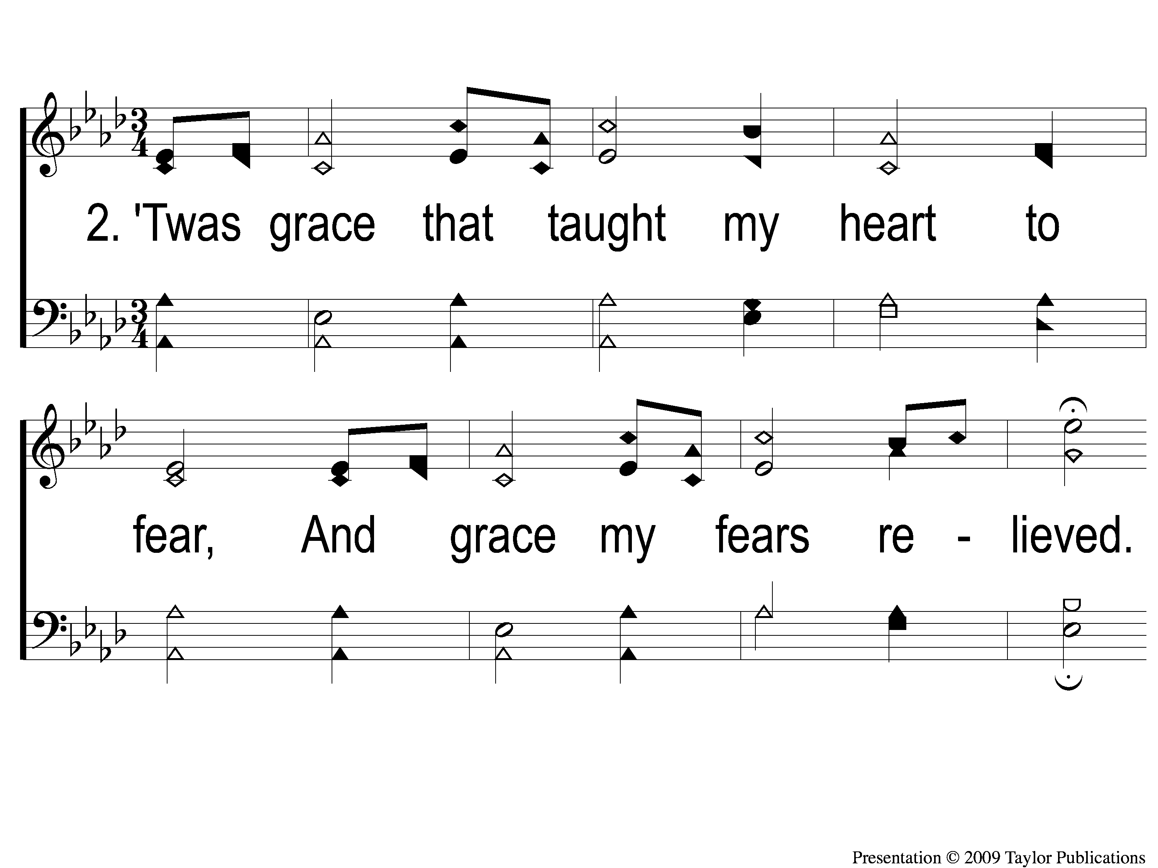
2-1 Amazing Grace
Amazing Grace
12

Slide 4
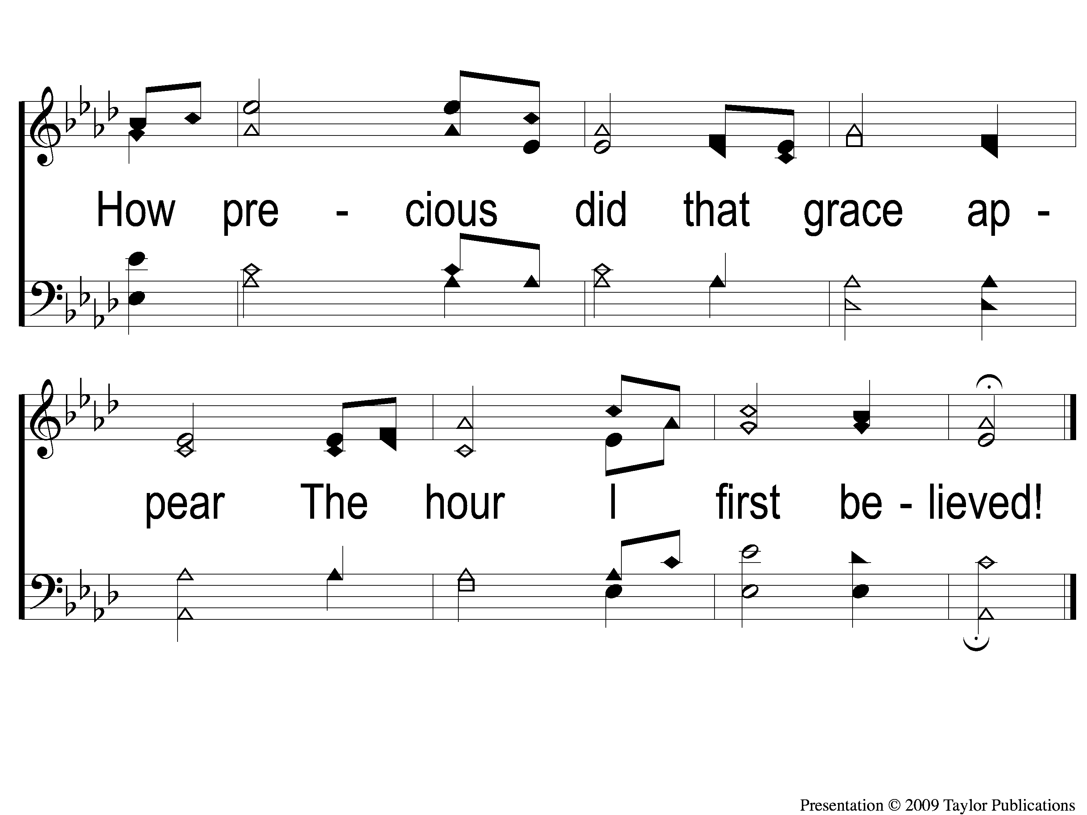
2-2 Amazing Grace
Amazing Grace
12

Slide 5
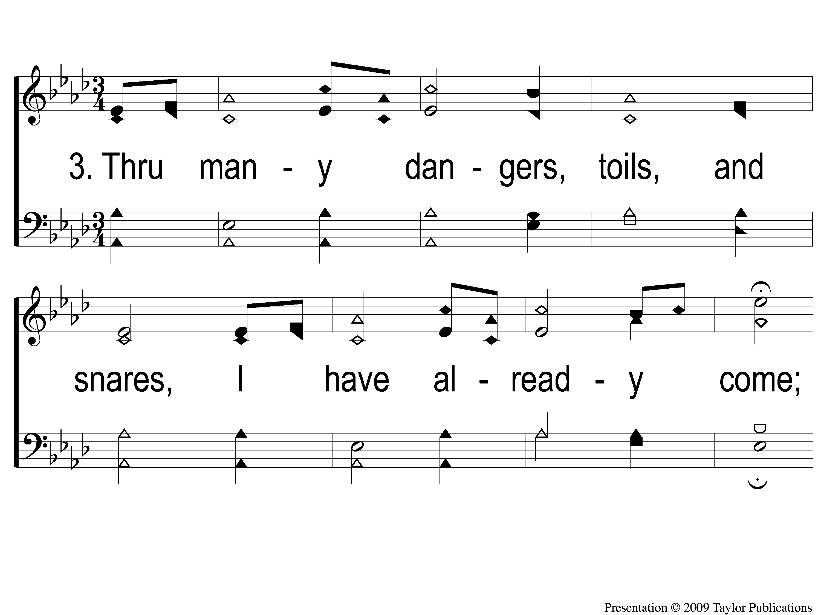
3-1 Amazing Grace
Amazing Grace
12

Slide 6
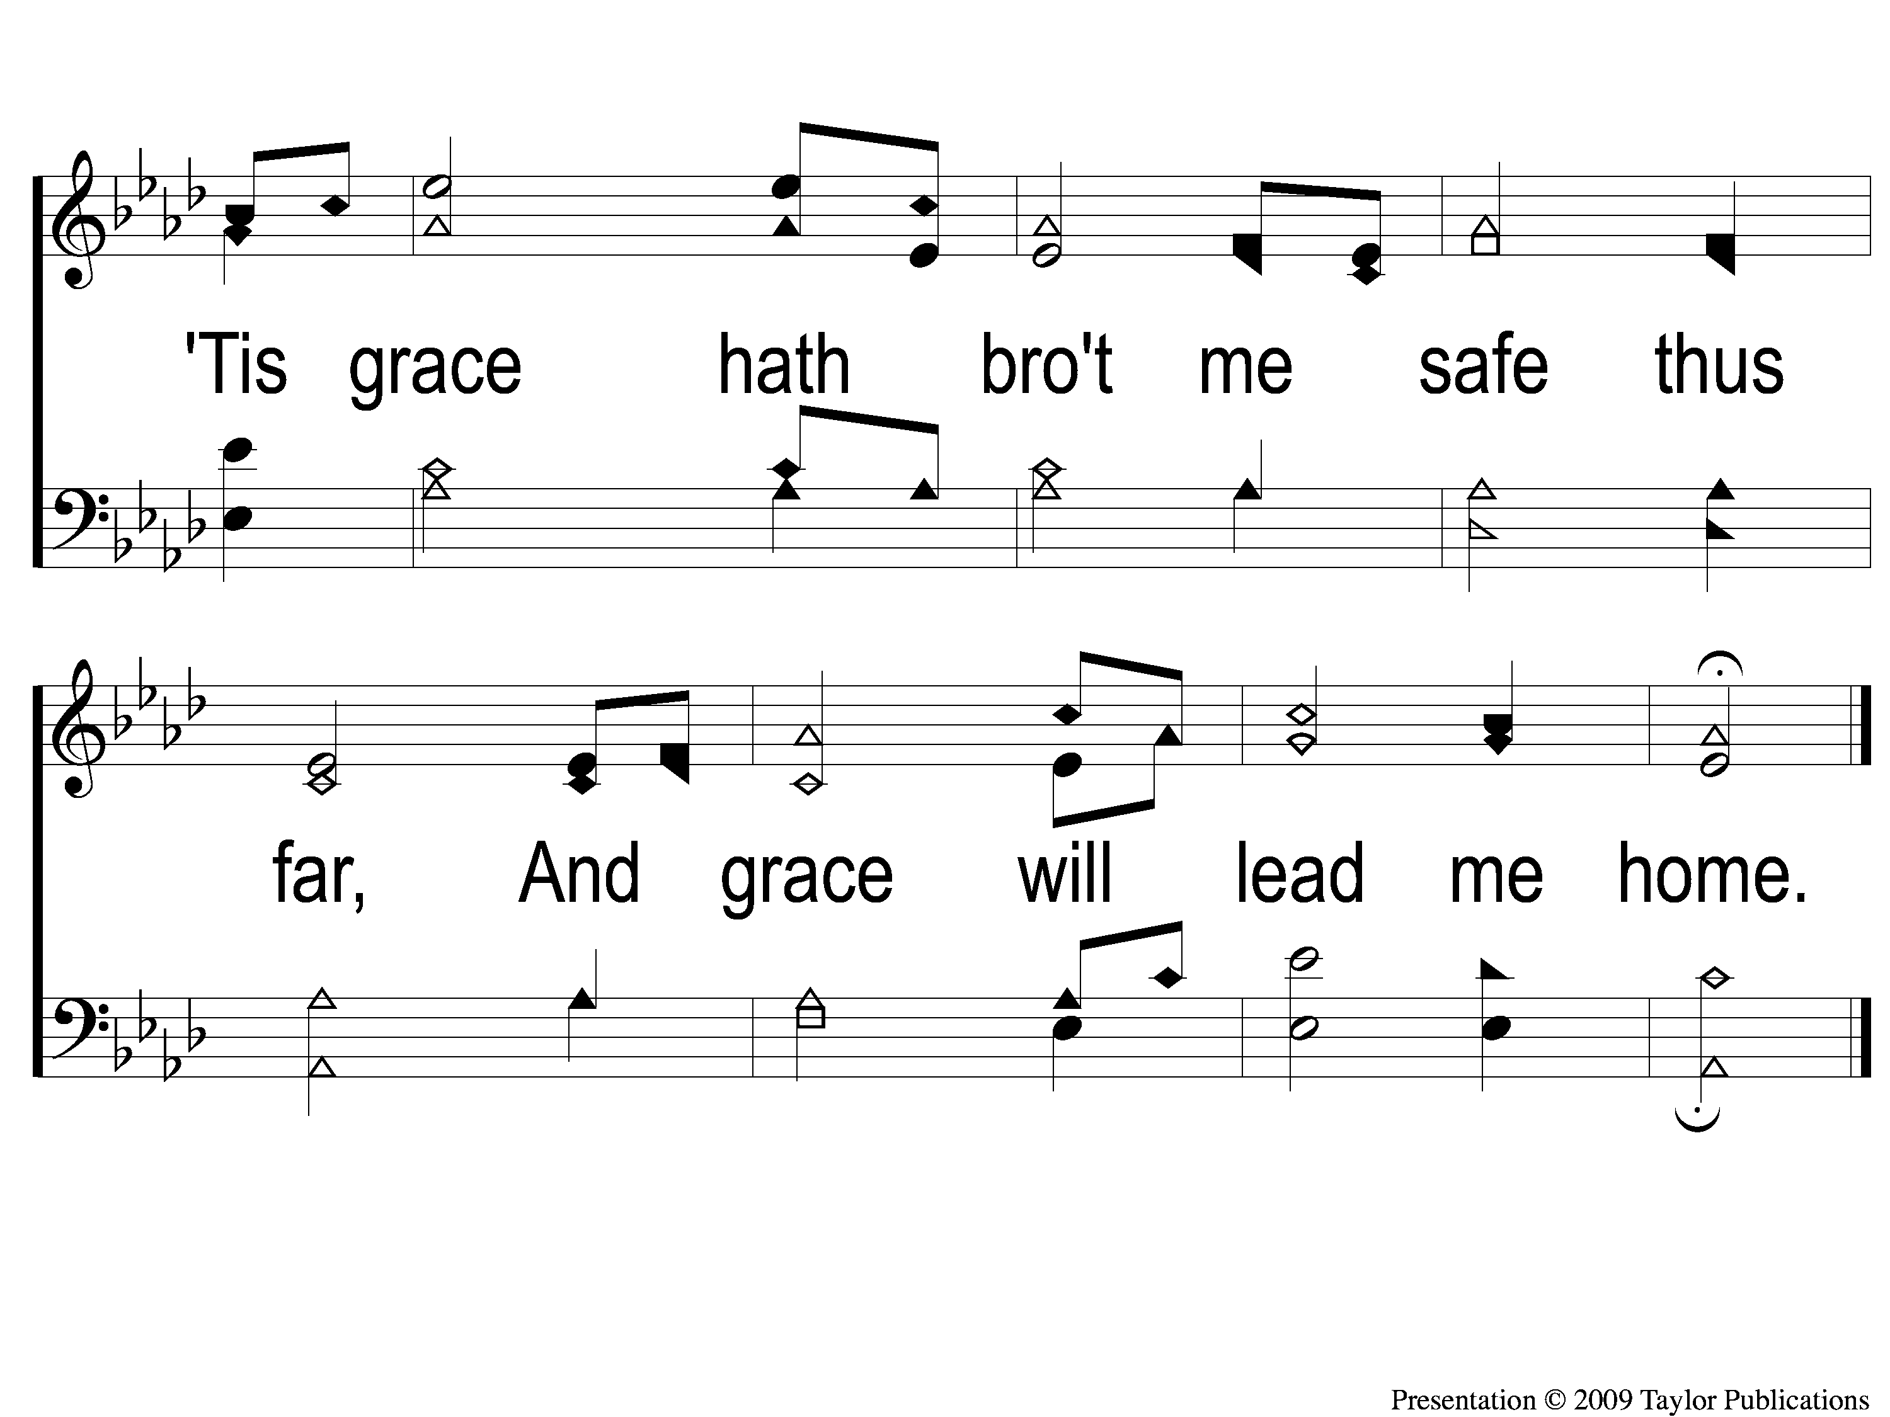
3-2 Amazing Grace
Amazing Grace
12

Slide 7
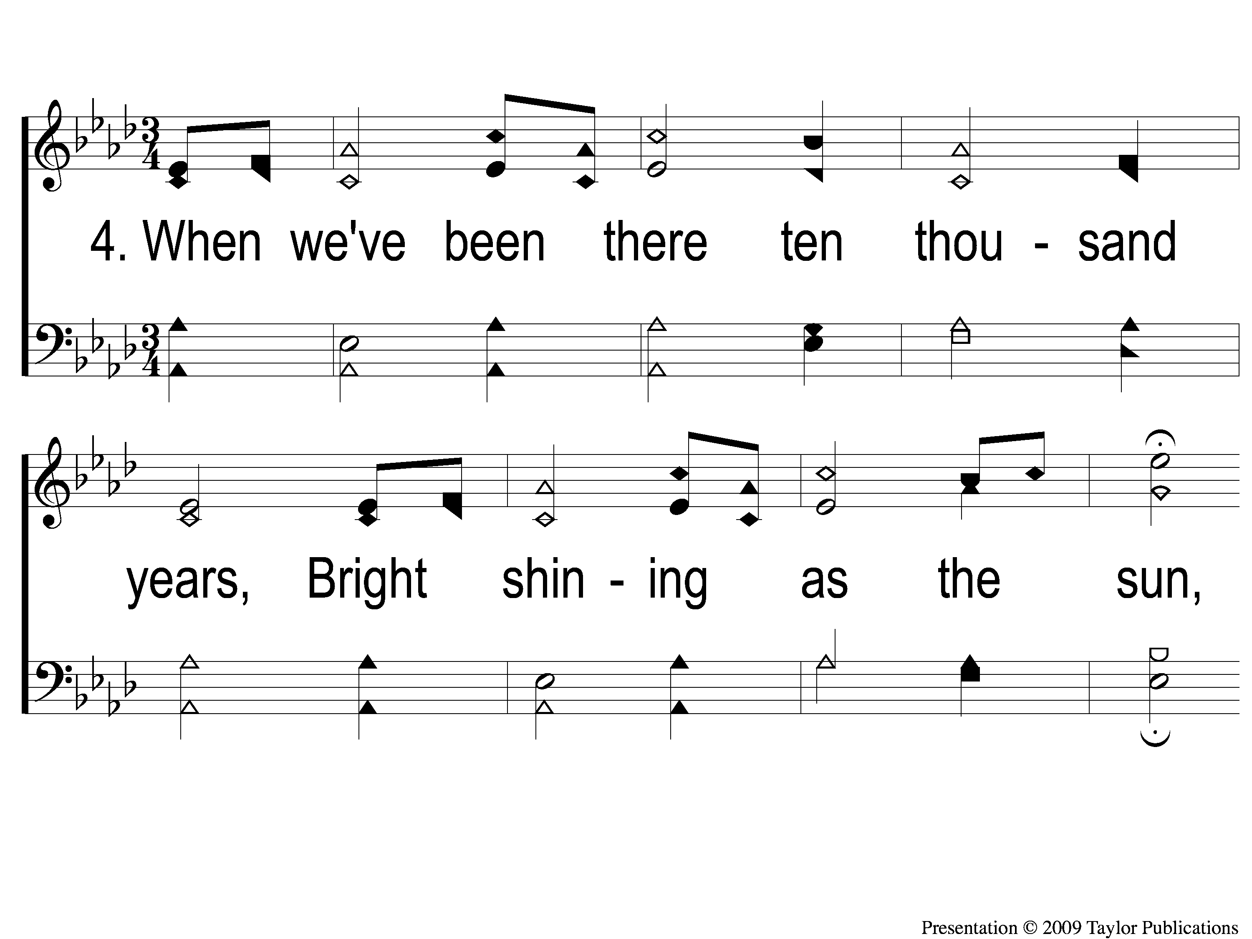
4-1 Amazing Grace
Amazing Grace
12

Slide 8
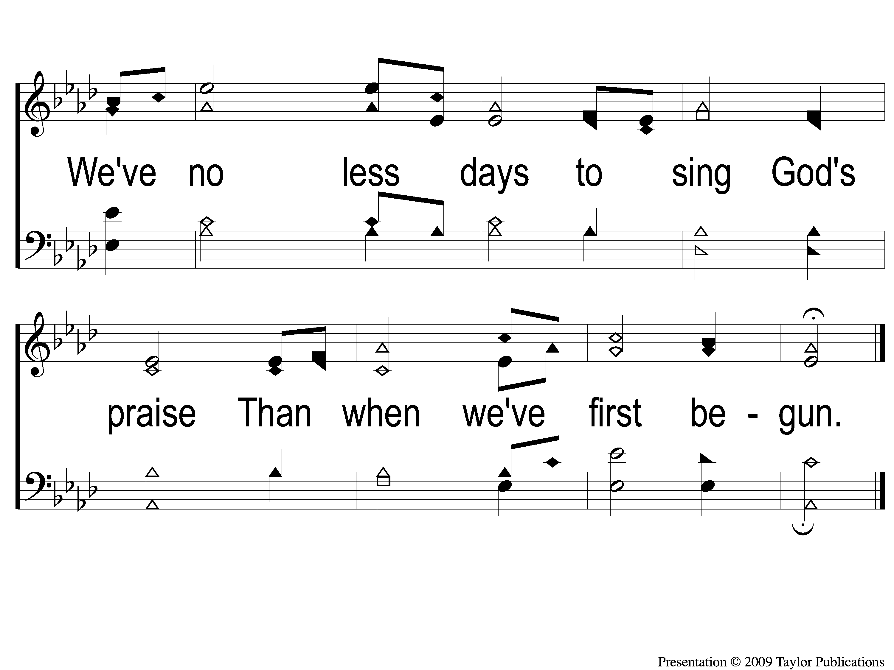
4-2 Amazing Grace
Amazing Grace
12

